Slide 1
Atmospheric Mercury Measurements
Winston Luke
NOAA/Air Resources Laboratory
June 22, 2016

Slide 2
Why Monitor Atmospheric Mercury?
ARL has a long history of research monitoring
Trend detection in response to regulatory emissions reductions and/or emissions increases (global)
Local/regional/global source attribution and characterization
Model evaluation
Test bed for process & QA studies, method evaluation and development
Notes:
The Air Resources Laboratory has a long history of establishing and operating a number of research monitoring networks, including daily precipitation (AIRMoN), atmospheric trace gases and aerosols (AIRMoN-Dry, no longer active), and climate variables (U.S. Climate Reference Network (USCRN)). ARL also serves in a leadership capacity with both the National Atmospheric Deposition Program and the World Meteorological Organization. The Global Monitoring Division (GMD) of the Earth Systems Research Laboratory in Boulder, CO was a division of ARL until the early 1990s, and focused on the monitoring of surface radiation budgets and greenhouse gases.
Although mercury emissions in North America have been dramatically reduced over the past 20 years, the pattern of global emissions is more complicated, and includes growing sources of mercury from developed and developing nations in Africa and Asia. The detection of trends and the characterization of emission source regions (local vs regional vs global) cannot be accomplished solely through atmospheric monitoring, but the partnership between monitoring and modeling is crucial to addressing these issues.

Slide 3
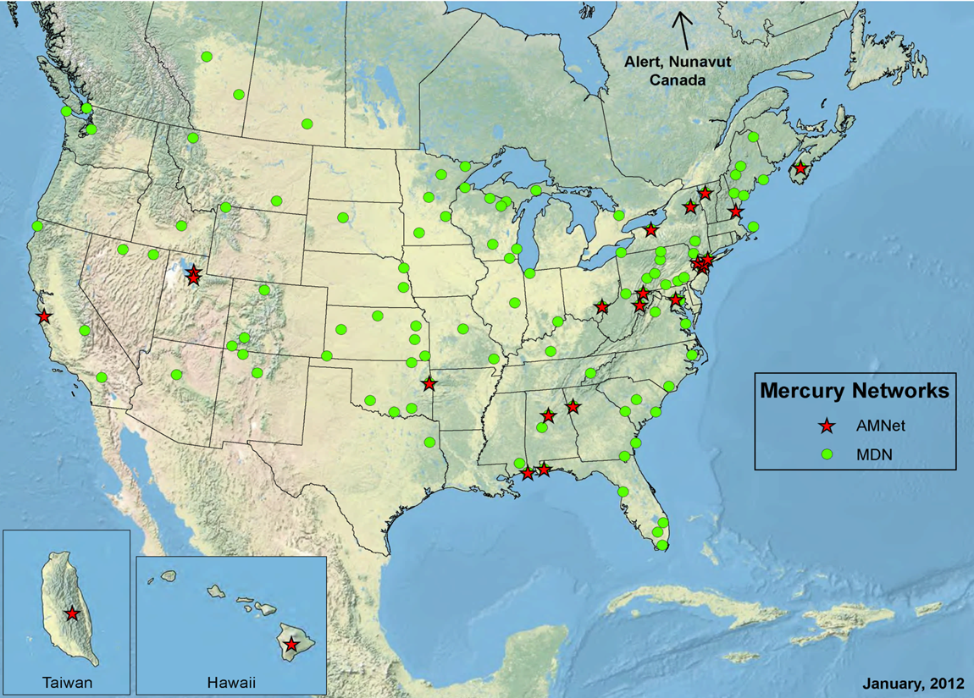
Long-Term Mercury Monitoring
(National Atmospheric Deposition Program)
Wet Deposition of Hg
Mercury Deposition Network (MDN)
Weekly precipitation collection, analysis at a central laboratory
113 Active Sites
Gas- and Aerosol-Phase Hg
Atmospheric Mercury Network (AMNet)
23 Active Sites
Real-time measurements of mercury species –expensive, technically challenging
Beltsville
Grand Bay
Mauna Loa
ARL operates 3 flagship AMNet sites (Beltsville, MD; Grand Bay NERR, MS; Mauna Loa, HI).
Notes:
The National Atmospheric Deposition Program is a cooperative program of research in which participating sites are individually funded by federal, state, and/or local governments, research institutes and universities, and the private sector. There are five monitoring networks within NADP –MDN, AMNet, the National Trends Network (NTN: weekly precipitation collection for major ions in solution –e.g., sulfate, nitrate, ammonium), the Atmospheric Integrated Research Monitoring Network (AIRMoN: daily/event precipitation collection for major ions), and the Ammonia Monitoring Network (AMoN: passive device sampling of atmospheric NH3). The cooperative approach established by NADP ensures that all sites within a network adhere to common operating and data reduction protocols, QA/QC requirements, and data dissemination guidelines.
ARL was a founding member of AMNet (est. 2009) and was instrumental in crafting standard operating protocols for the network. The laboratory runs three of twenty three sites currently active within AMNet. The Beltsville, MD site is on the campus of the USDA’s Beltsville Agricultural Research Center (BARC). The Grand Bay National Estuarine Research Reserve (NERR) site is in Moss Point, MS near the MS-AL state line in the northern Gulf of Mexico region. Finally, the site at the Mauna Loa Observatory is a high-altitude site on the northern slope of the Mauna Loa volcano, on the Big Island of Hawaii.

Slide 4

What We Measure in AMNet
Gaseous Elemental Mercury (GEM)
  most of total Hg in atmosphere
  doesn’t easily dry or wet deposit
  globally distributed
Gaseous Elemental Mercury (GEM)
  95% + of total Hg in atmosphere
  largely inert: doesn’t easily deposit
  lifetime ~6 to 12 months
  globally distributed ~1.3 ng m-3 in NH
Gaseous Oxidized Mercury (GOM)
  a few % of total Hg (pg m⁻³)
  oxidized Hg (HgCl₂, others)
  very water soluble and “sticky”
  lifetime of a few days in PBL
  bioavailable
Particulate-Bound Mercury (PBM)
  a few % of total Hg (pg m⁻³)
  Hg in/on particles
  variable solubility
  atmos. lifetime ~1-2 weeks
  bioavailability is uncertain
Notes:
With current measurement techniques, GOM is operationally defined by collection on an annular denuder coated with KCl. Concentrations of GOM in the atmosphere are exceedingly low, and it is currently impossible to measure concentrations of individual GOM species with specificity and accuracy. The bulk of GOM is thought to be comprised of mercuric halides (HgCl2, HgBr2, HgI2).
Because GOM compounds are water soluble their lifetimes in the lower troposphere are determined by the average frequency of precipitation events, along with dry deposition to natural surfaces under clear conditions. GOM formed in the upper troposphere, however, may be considerably longer lived and may undergo long-range transport.
As with GOM, little is known of the precise chemical formulation of PBM. The underlying solubility of PBM is determined by the solubility of the internally- or externally-mixed particles to which it is bound. Because the scavenging of atmospheric particles by rainout is generally less efficient than for trace gases, PBM lifetimes should be somewhat longer than that of GOM, but can also be influenced by particle settling dynamics (dry deposition). The potential bioavailability of deposited PBM is uncertain, and will depend on numerous factors (e.g., the extent to which mercury can be leached from the particles after deposition).

Slide 5
Mercury and Ancillary Measurements
Site | Collaborators | Ambient Air Measurements |  |  |  |  |  | Precipitation |  |  | Dry Deposition |  | Other
 |  | Mercury Speciation | SO₂ | O₃ | NO/NO_{y} | CO | Black Carbon | Major Ions (NTN) | Mercury (MDN) | Trace Metals | Surrogate Surface | Throughfall | Meteorology
Beltsville (MD) | EPA Clean Air Markets Division Univ. of MD; Maryland DNR AMEC Foster-Wheeler; USGS; USDA |  | • | • | • |  |  | • | • |  |  | • | •
Grand Bay (MS) | Grand Bay NERR, NOAA-NCCOS MS Dept. of Env. Quality U.S. Fish and Wildlife Service |  | • | • | • | • | • | • | • | • |  |  | •
Mauna Loa (HI) | U.S. EPA NOAA ESRL Many others | • | • | • |  | • | • |  |  |  |  |  | •
NOAA/ARL Measurements
Measurements by Partners
Notes:
At the Grand Bay and Mauna Loa sites, NOAA/ARL operates the chemical analyzers for trace gas and aerosol measurements in addition to speciated mercury measurements. At Grand Bay, ARL also makes continuous meteorological measurements. At both Grand Bay and Beltsville, ARL maintains duplicate Tekran® speciation analyzers for atmospheric mercury, a rarity in AMNet. Operating co-located measurement systems asynchronously allow for truly continuous measurement of atmospheric mercury species as each measurement system operates on a 50% measurement duty cycle. Synchronous operation of the instruments facilitates QA/QC and comparison studies, and testing of improvements to the SOPs.

Slide 6
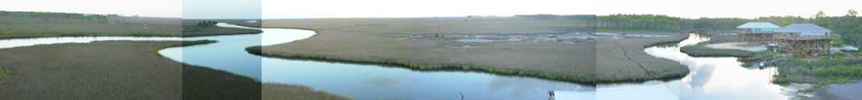
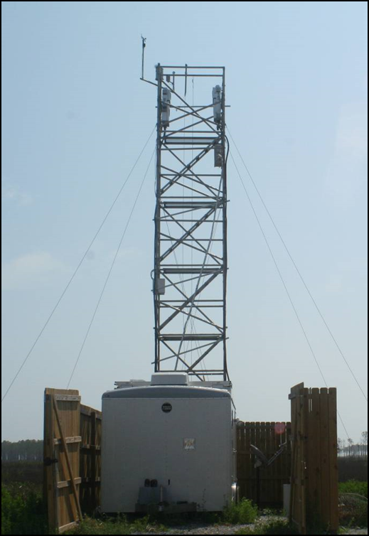
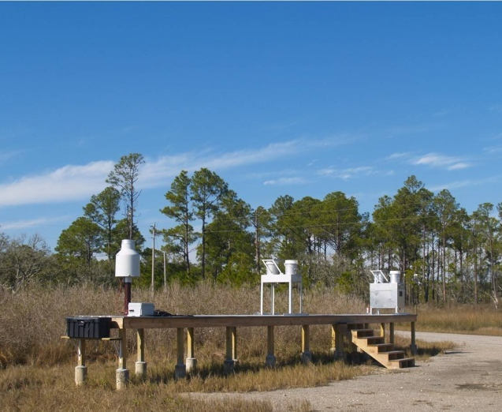
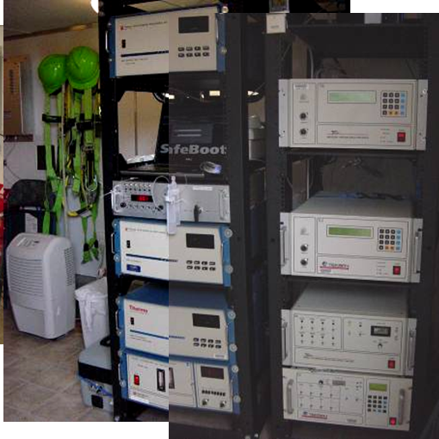
ARL Measurement Sites
Grand Bay National Estuarine Research Reserve (NERR), Mississippi
view from the top of tower
Mercury measurements
precipitation collection
Meteorological
measurements
Trace gas
measurements
Since 2007: A rural coastal site in the SE U.S.,
5 km from the open waters of the Gulf of Mexico
Notes:
The Grand Bay site was established in late 2006, but routine measurements began in 2007. The site sits at the edge of Bayou Heron (top photo), an area of marsh grasses and inland waterways. The open waters of the Gulf of Mexico lie a few kilometers beyond the bayou.
Given its location, the site can be vulnerable to flooding arising from intense precipitation events and cyclonic activity. The trailer housing the chemical analyzers, data loggers, and support equipment can be moved within a few hours if severe weather threatens. ARL measures atmospheric mercury and other trace species at a height of approximately 10 m above ground level to minimize depositional losses of reactive species and to avoid the effects of natural surfaces on meteorological variables. As a result, measurements should be more representative of the lower PBL.
Precipitation at the site is collected for analysis of mercury and other toxic metals (MDN) as well as major ions in solution (NTN). An electronic rain gauge provides a measure of precipitation amount. In addition, passive samplers for GEM are deployed in collaboration with the University of Toronto, and a sampler for isotope studies has been deployed in collaboration with USGS.

Slide 7
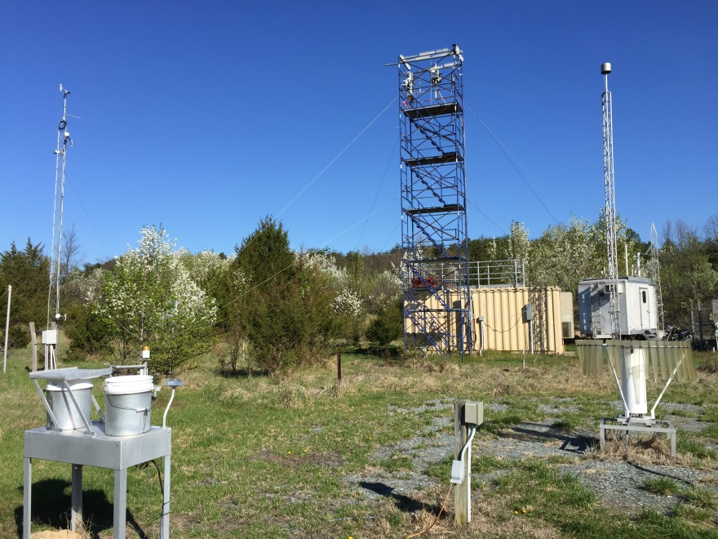
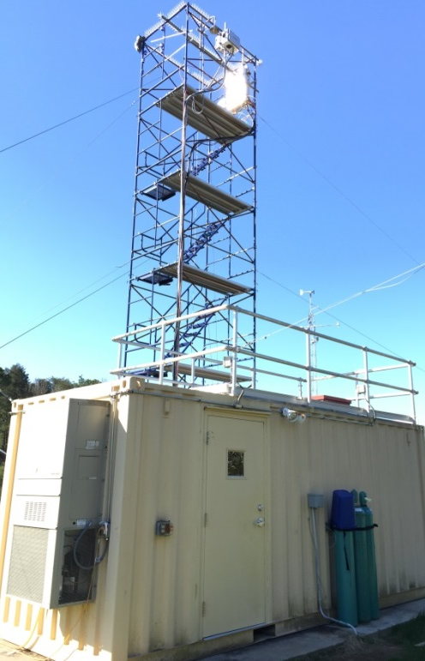
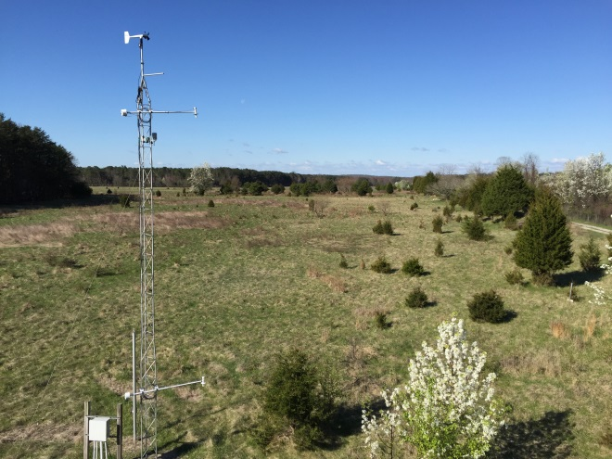
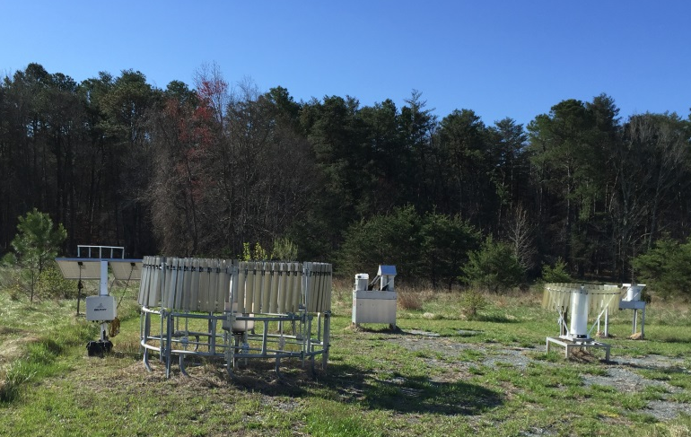
ARL Measurement Sites
Beltsville, Maryland
Since 2007:
A suburban
site NE of Washington, DC
Also an EPA Clean Air Status and Trends Network site
view from the
top of tower
precipitation collection
Notes:
As at Grand Bay, meteorological and trace gas and aerosol measurements at Beltsville are made at 10 m AGL. The site also hosts MDN and NTN precipitation collectors for their respective networks. In addition, passive samplers for GEM are deployed in collaboration with the University of Toronto, and a sampler for isotope studies has been deployed in collaboration with USGS, which also measures mercury in litterfall at the site.

Slide 8
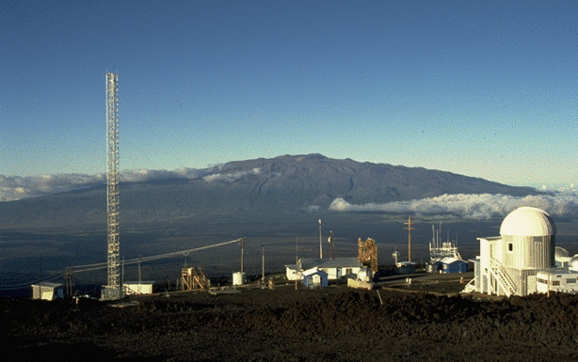
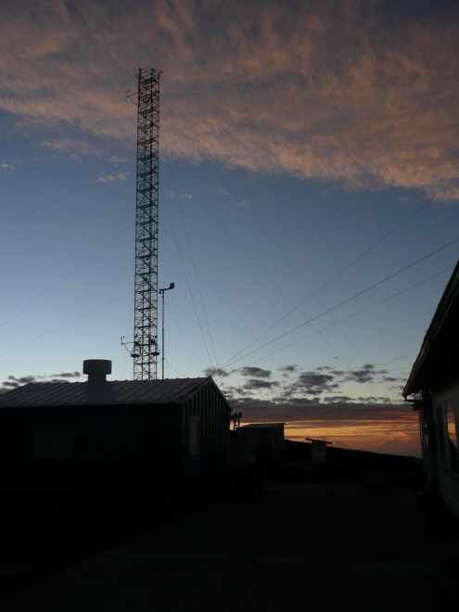
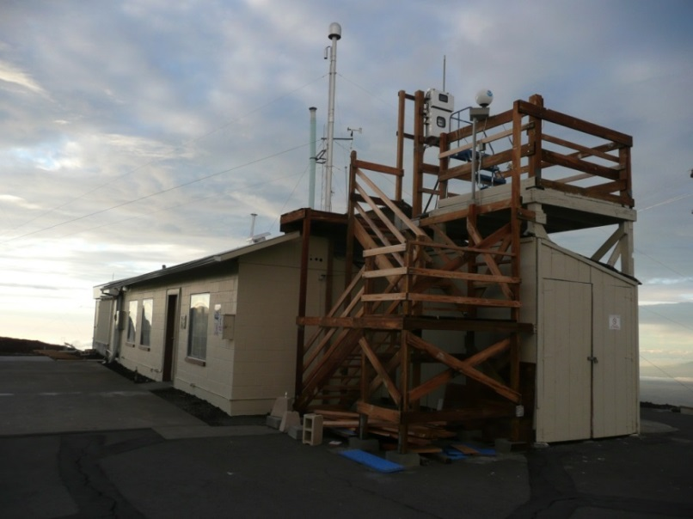
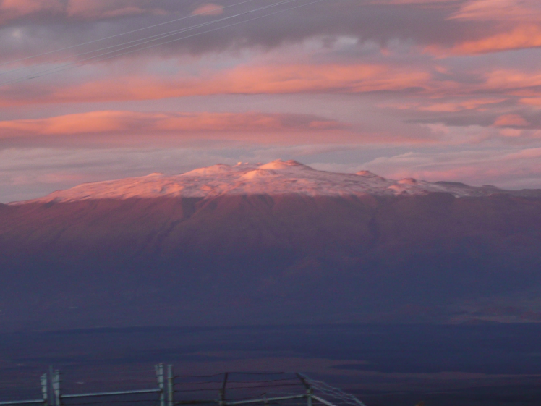
ARL Measurement Sites
Mauna Loa Observatory, Hawaii
The Mauna Loa Observatory with Mauna Kea in the background.
Since 2011:
Located at 3,397m on the north slope of the Mauna Loa volcano
Premier site for the study of background atmosphere (NOAA ESRL)
Mauna Loa is also affiliated with GMOS (Global Mercury Observation System)
Copyright by Forrest M. Mims III
CO₂ measurement tower
Mercury measurements from
the historic Keeling Building
Mauna Kea in winter, as seen from MLO
Notes:
The Mauna Loa Observatory was established in 1956 and hosts the monitoring of trace gas and aerosols, as well as meteorology and solar radiation, relating to changes in atmospheric composition. The observatory is operated by NOAA’s Earth System Research Laboratory. MLO is the world's oldest continuous CO2 monitoring station, and the world's primary benchmark site for measurement of the gas. It is from MLO’s CO2 data record that the Keeling curve was constructed.
Logistical considerations prevent the measurement of mercury species at 10 m AGL at MLO. Measurements are instead made at a height of 6 m AGL. Passive samplers for GEM are deployed in collaboration with the University of Toronto, and a sampler for isotope studies has been deployed in collaboration with USGS at MLO.

Slide 9
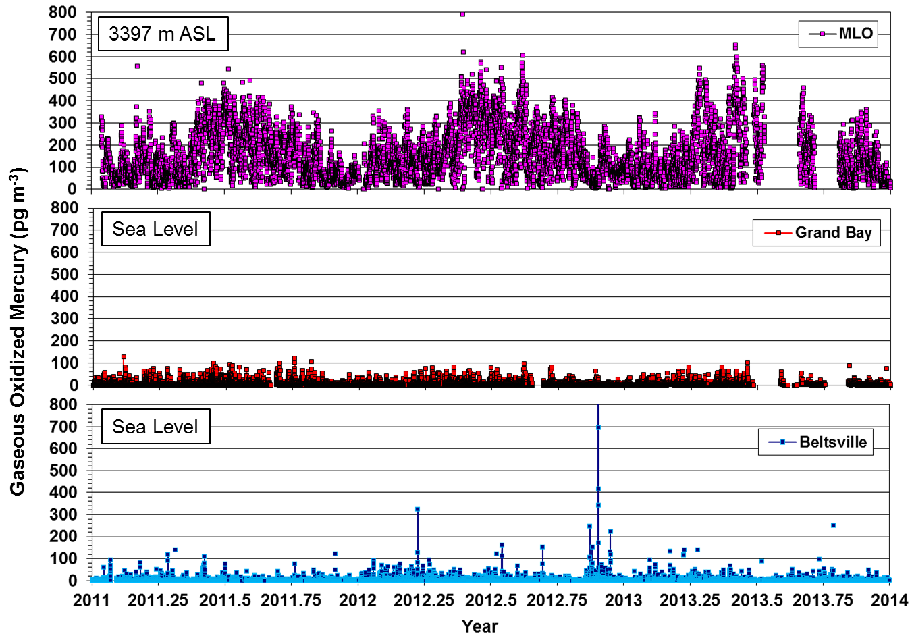
Comparison Across Three Sites
Notes:
Sea level sites (Grand Bay, Beltsville) display a slight seasonal dependence of GOM (highest in Spring and Summer). Typical GOM concentrations at sea level are a few tens of picograms per cubic meter, with higher levels reported when the sites are impacted by local and regional emission sources. By contrast, GOM concentrations in night-time flow at MLO (air masses characteristic of the free troposphere) display a pronounced seasonal dependence in the background global atmosphere. Air masses encountered at MLO are characteristic of the remote Pacific, and are only occasionally impacted by emission source regions in Asia. In this remote setting, GOM levels can reach several hundred picograms per cubic meter (1-2 orders of magnitude higher than sea level sites) and GOM can constitute a significant fraction of total mercury.

Slide 10
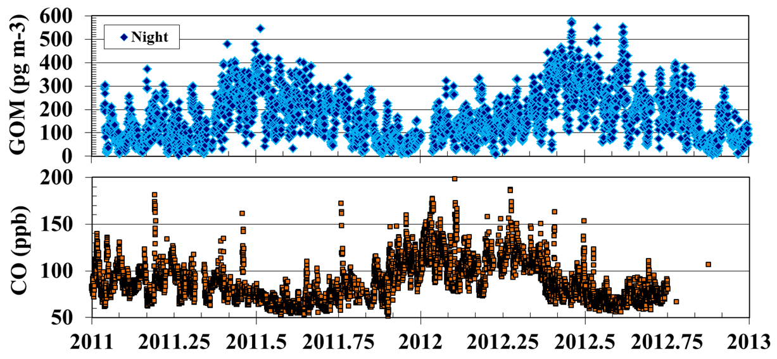
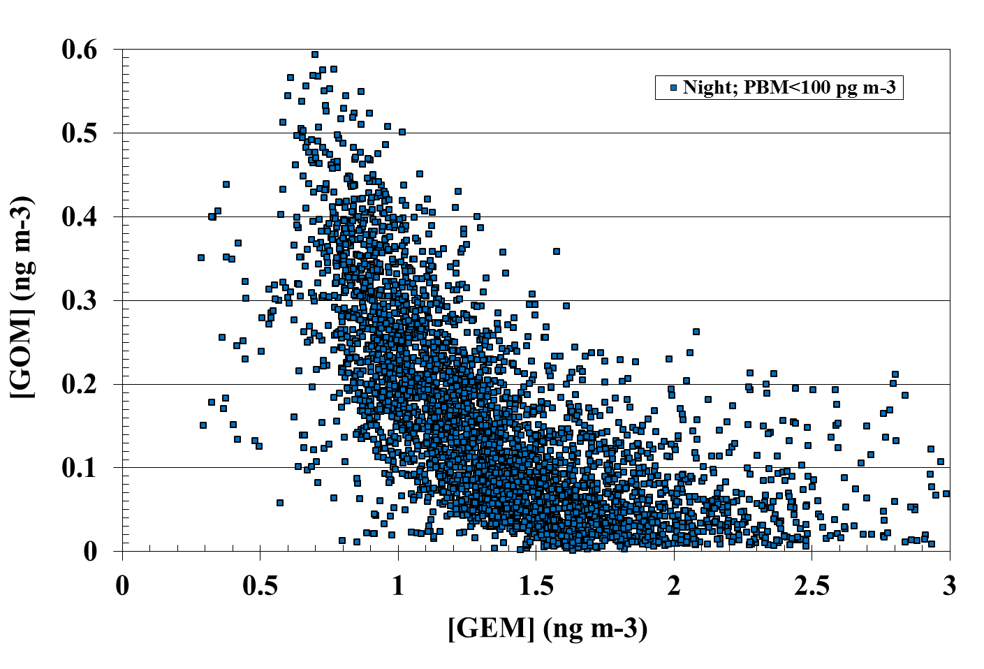
Mauna Loa
Summer maxima of GOM correspond to minima in CO (driven by increased ·OH oxidation) and suggest a photochemical origin of GOM from direct oxidation (O₃? ·OH? Br ·?) of GEM in the free troposphere
Notes:
In the remote atmosphere, concentrations of CO are controlled by reaction with the hydroxyl radical (OH), which oxidizes CO to CO2 and regulates the lifetime of CO to ~2 months. The hydrodxyl radical results from the interaction of ozone, sunlight, and water vapor and its concentration correlates with solar intensity. Summertime CO concentrations are thus at a minimum, when concentrations of OH are at their peak. GOM concentrations are highest in summer, suggesting that photochemical processes may give rise to its generation in the free troposphere. While the precise oxidant responsible for mercury oxidation is uncertain (candidates include ozone, hydroxyl radical, and/or halogen radicals), the inverse relationship between GEM and GOM suggests the direct oxidation of GEM to GOM.

Slide 11
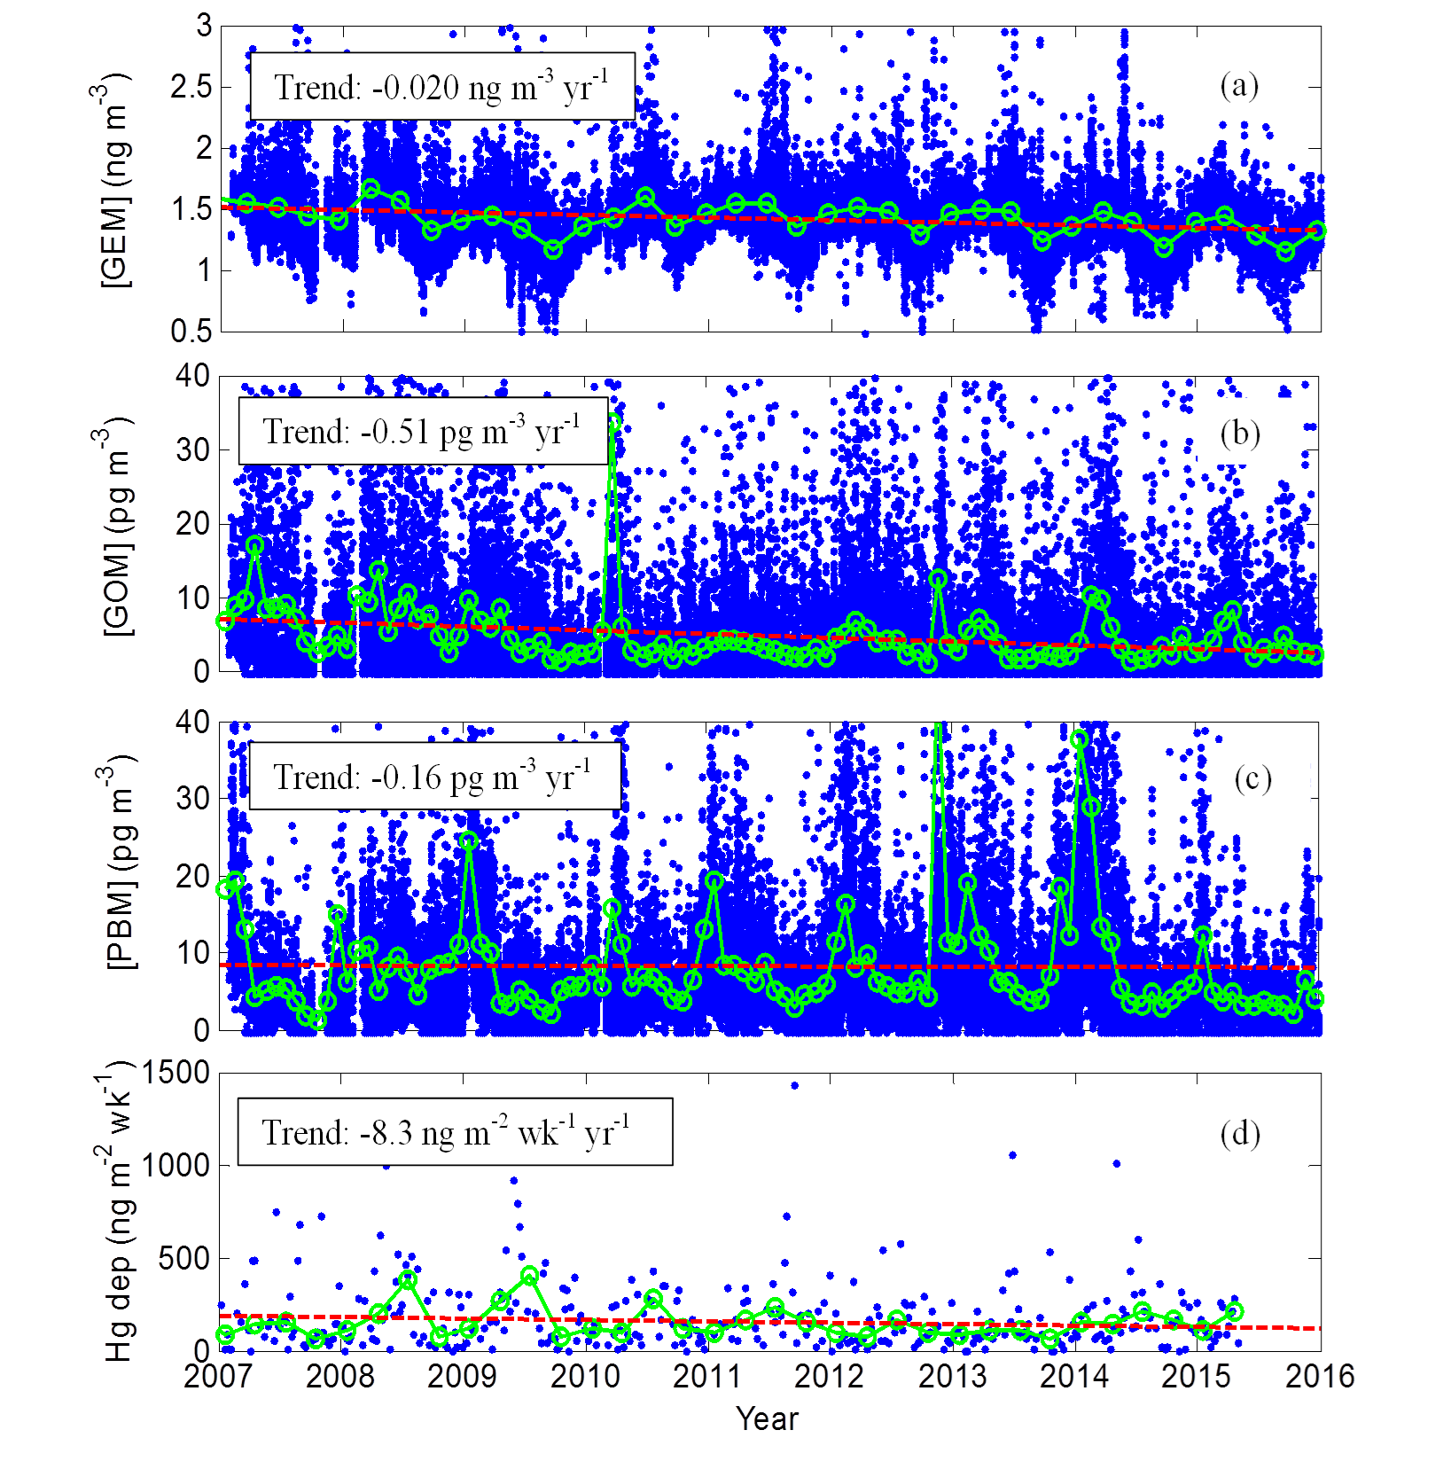
Trend Detection
Trends in concentrations of GEM, GOM, and PBM, and in total mercury deposition from 2007-2015 at the Beltsville, Maryland AMNet site (see poster by Ren).
Notes:
Concentrations of all forms of mercury have been declining at the Beltsville, MD AMNet site, as they have at many locations in the United States. While the site is impacted by local, regional, national, and even global sources, this downward trend would suggest that local and regional emission sources, which have been declining in response to mandated and market-driven reductions, play a significant role in influencing concentrations at the site. It is possible that the downward trends at Beltsville may be confounded and lessened somewhat by increases in mercury emissions from Asia and other global sources, and may in fact have been larger in the absence of this global influence.

Slide 12
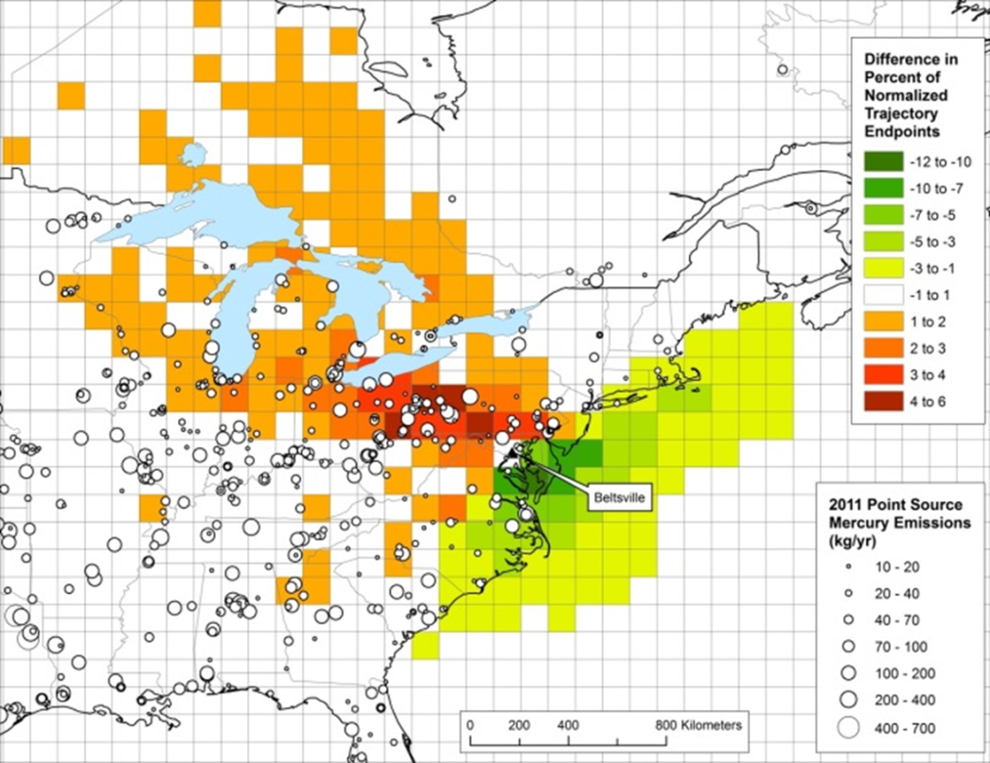
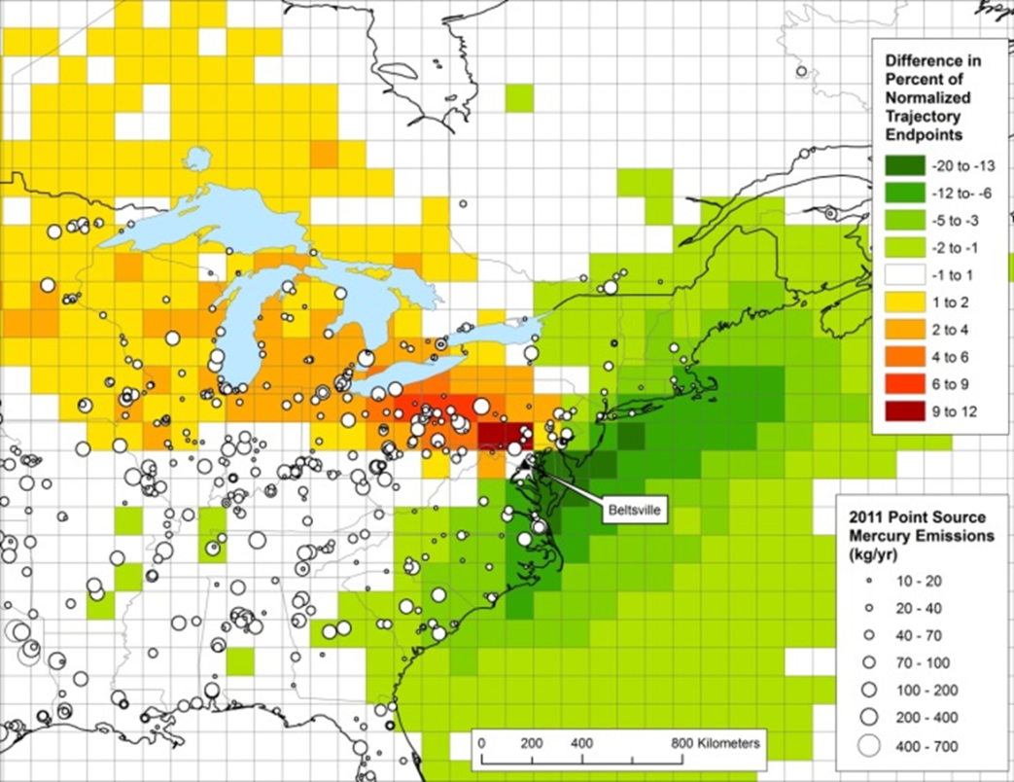
Source Identification
GOM
PBM
Marrying HYSPLIT back trajectory frequency calculations with mercury measurements at Beltsville identifies the emission source regions impacting the site. Reds/oranges indicate those regions more likely to have been encountered during high [GOM] & [PBM] events (see poster by Ren).
Notes:
Shown are differences in frequencies for each grid cell between the back trajectories associated with the top 10% and bottom 38% of measured GOM hourly values; for PBM, the differences are between the back trajectories associated with the top 10% and bottom 10% of measured PBM hourly values at Beltsville. Reds and oranges denote those grid squares which were more likely to have been encountered by air masses arriving at the site, while green colors represent those grid squares which were less likely to have been encountered prior to arrival at the site. Note that point sources are denoted as circles on the maps. Source strength is based on the 2011 National Emissions Inventory.

Slide 13
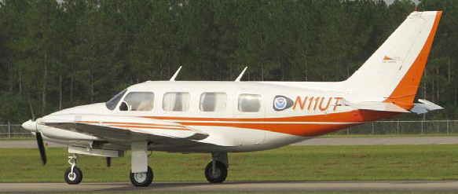
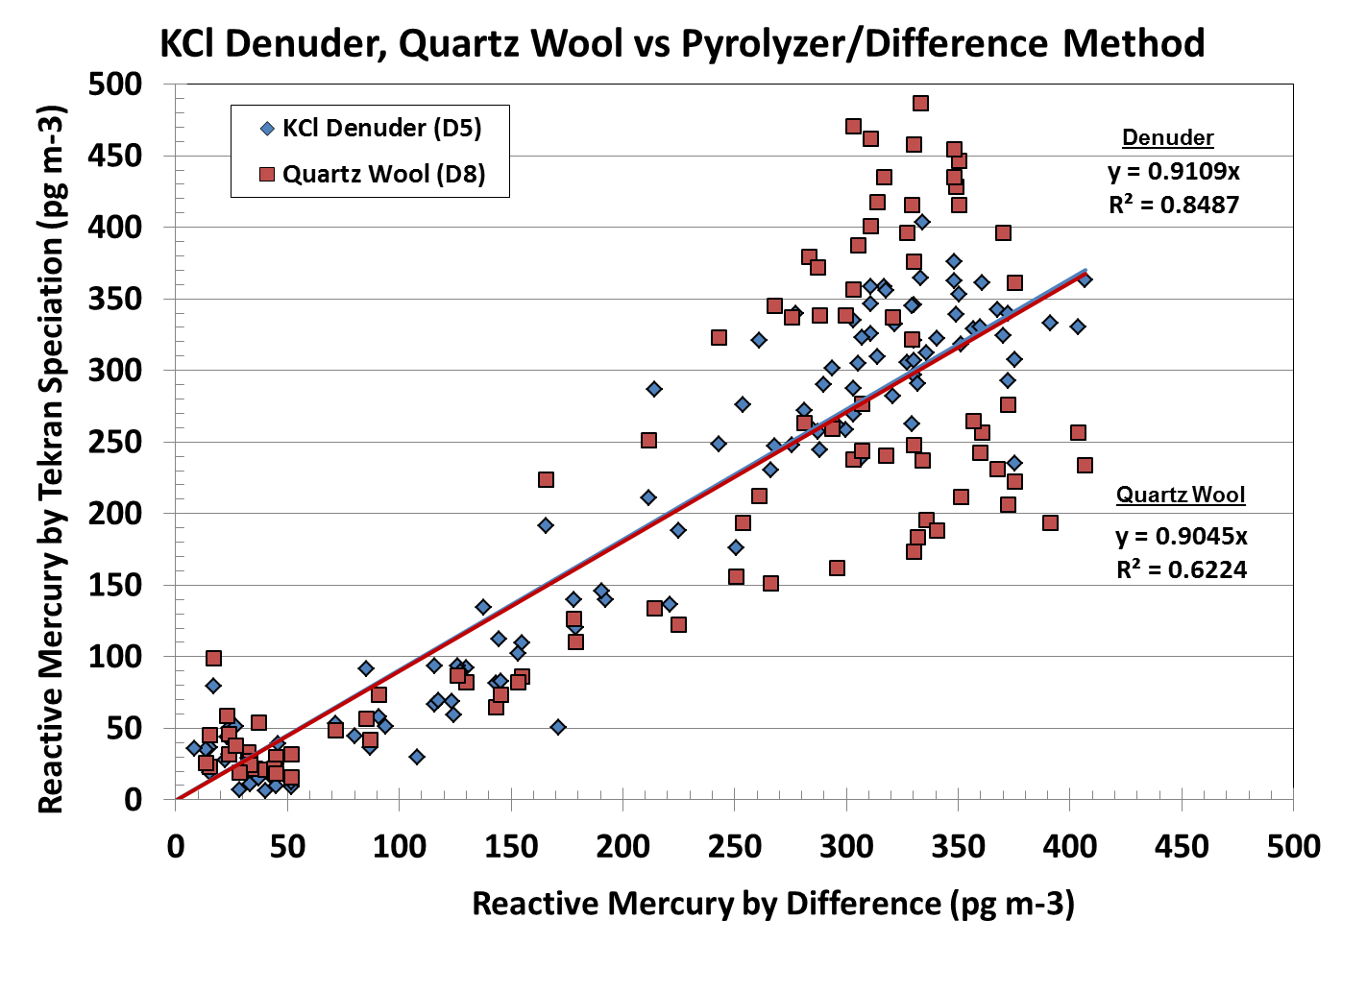
Process Studies & Field Intensives
Gaseous Oxidized Mercury
Gaseous Oxidized Mercury
MLO
University of Tennessee Space Institute Piper Navajo
Technique Intercomparison at Mauna Loa Observatory
Ongoing study takes advantage of Mauna Loa’s elevated [GOM] –a “natural laboratory.”
Results will help to identify and mitigate or correct sources of bias and inaccuracy in current monitoring techniques.
Notes:
ARL partnered with EPA/ORD in 2000 to conduct some of the first airborne measurements of atmospheric mercury species. From 2011-2013 ARL collaborated with scientists and staff from the University of Tennessee Space Institute to measure GEM and GOM from a small research aircraft. Measurements were made over Mississippi near the Grand Bay site, and over central Tennessee, in close proximity to UTSI facilities. The altitude profile demonstrates the seasonality of GOM concentrations, as measurements in August and September are typically much higher than in Fall or Winter. The elevation of the MLO site (3397 m) is shown as a dashed line, and is near the maxima in the GOM profiles.
ARL is engaged in method development and comparison studies at MLO, with an emphasis on improving measurement techniques for GOM. These intensive measurements necessitate the installation of duplicate speciation systems and the deployment of a pyrolyzer-based method to measure total mercury. In the absence of a robust calibration device for GOM, we have taken advantage of the high ambient GOM concentrations at MLO to provide a large measurable signal for comparison purposes.

Slide 14
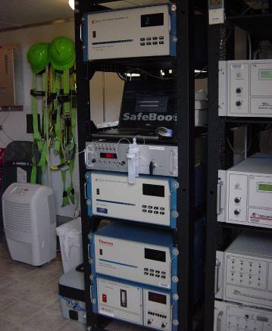
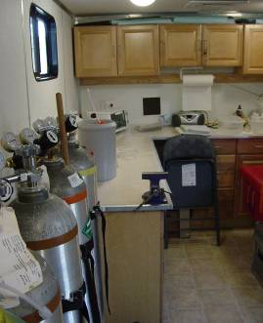
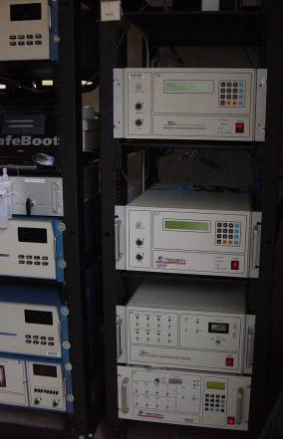
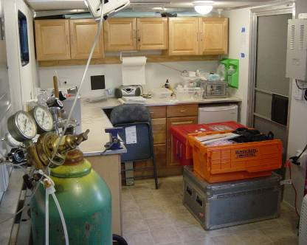
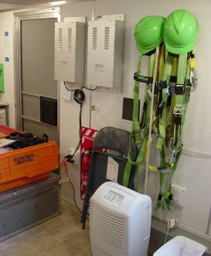
Accomplishments
Long term, high-quality, publicly available data sets for
atmospheric chemistry
trend analysis
local vs. long-range transport
source-receptor studies
model evaluation
Method development
improved accuracy, operational robustness
reduction of sample bias, artifact losses
Advances in scientific understanding
vertical distributions
source characterization
Inside the instrument trailer at the Grand Bay NERR mercury monitoring site

Slide 15
Quality, Relevance, and Performance
NOAA/ARL is a founding member of and key contributor to AMNet, and operates 3 of 23 sites in the network. ARL measurements are regarded as being of high quality, and the sites feature redundant Hg measurements.
Collaborates with and secures funding from other agencies (e.g., EPA).
Was instrumental in developing standard operating protocols for AMNet in 2008, and held a Mercury Measurement Workshop in Sept. 2015 to revisit, assess and improve initial AMNet protocols.
Provides technical guidance (with NADP and EPA partners) for development and implementation of Asia-Pacific Mercury Monitoring Network.
To date, 10+ peer reviewed publications using ARL-generated data, several additional manuscripts in preparation.

Slide 16
Collaborations
NOAA
Grand Bay National Estuarine Reserve
Nat’l Centers for Coastal & Ocean Science
Earth Systems Research Laboratory (ESRL)
National Weather Service (NWS)
Universities and Institutes
Florida State University
University of Houston
University of Maryland
University of Tennessee Space Institute
University of Miami (Florida)
Georgia Institute of Technology
University of Nevada
University of Illinois
Valparaiso University
Exploratorium (San Francisco)
Other Federal Agencies
EPA Clean Air Markets Division (CAMD)
U.S. Fish and Wildlife Service
Department of Agriculture
National Park Service
U.S. Geological Survey
International
European Commission/GMOS
Environment Canada
Asia-Pacific Mercury Monitoring Network
EPA Taiwan
National Central University (Taiwan)
University of Toronto
State and Local Governments
Maryland, Mississippi, Pennsylvania, Texas, Alaska, Virginia, West Virginia
Industry
TEKRAN
Electric Power Research Institute
Southern Company

Slide 17
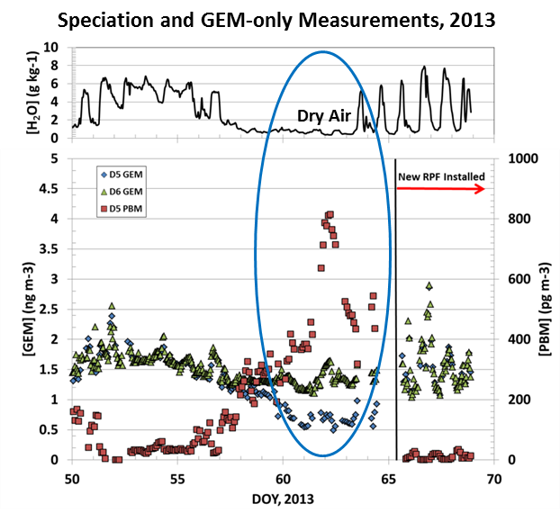
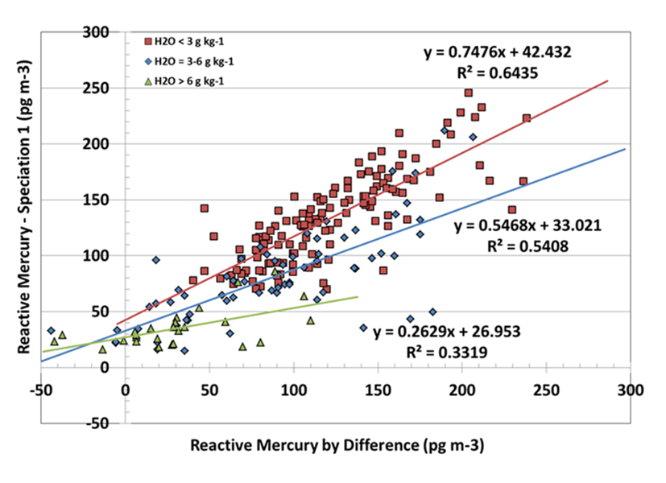
Remaining Challenges
Recent research has identified artifacts in PBM, GOM measurements (see poster by Luke).
We developed calibration protocols to assess the severity of these artifacts and biases (see poster by Kelley).
Notes:
The plot at left shows results from two co-located mercury measurement systems, one speciation unit measuring GEM, GOM, and PBM, and the other measuring GEM only. We have discovered that the quartz glassware used to collect and measure PBM can become contaminated with minerals contained in refractory aerosols (possibly from Asian or Saharan dust episodes). In dry air, these aerosols embedded within the measurement system can adsorb GEM and release it upon thermal desorption, giving rise to artifact (spurious) PBM concentrations. This artifact may be seen by the simultaneous increase in PBM (D5; red squares) and decrease in GEM (D5; blue diamonds) reported by the speciation unit. The GEM-only instrument (D6; green triangles) was not affected by the artifact and reported more accurate GEM concentrations. This artifact formation can significantly hamper our understanding of the global mercury cycle and lead to the spurious overestimation of the reactive mercury pool. This, in turn, can hamper our understanding of mercury budgets and lifetimes in the atmosphere.
At right, reactive mercury (RM) reported by a conventional speciation system (RM = GOM+PBM, and is typically dominated by GOM) is compared with data generated using a pyrolyzer- difference technique. The degradation of the ability of the KCL-coated denuder to collect GOM in moist air is illustrated by the smaller regression slopes at higher water vapor mixing rations (MR).

Slide 18
Future Directions
Evaluate, intercompare, and optimize existing measurement methods
Develop new methods, e.g.,
  pyrolysis-difference method
  relaxed-eddy-accumulation (REA) system for dry deposition
Additional measurements at long-term sites
Field intensives at ground (and aloft?) for process studies to address key uncertainties
Analysis and publication of datasets

